Slide 1

PROJECT OVERVIEW
EASY
ADVANCED

Slide 2
PROJECT OVERVIEW
In this project, we will leverage the power of data Wrangler service in AWS to prepare, clean and visualize the data.
We will analyze the Titanic dataset which contains features related to Titanic passengers and cardiovascular disease datasets (final project).
Here are the key learning outcomes:
Understand feature engineering strategies and tools.
Understand the fundamentals of Data Wrangler in AWS.
Perform one hot encoding and normalization.
Perform data visualization Using Data Wrangler.
Export a data wrangler workflow into Python Script.
Create a custom formula and apply it to a given column in the data.
Generate summary table tables in Data Wrangler.
Generate bias reports.

Slide 3
SAGEMAKER DATA WRANGLER 101
EASY
ADVANCED

Slide 4
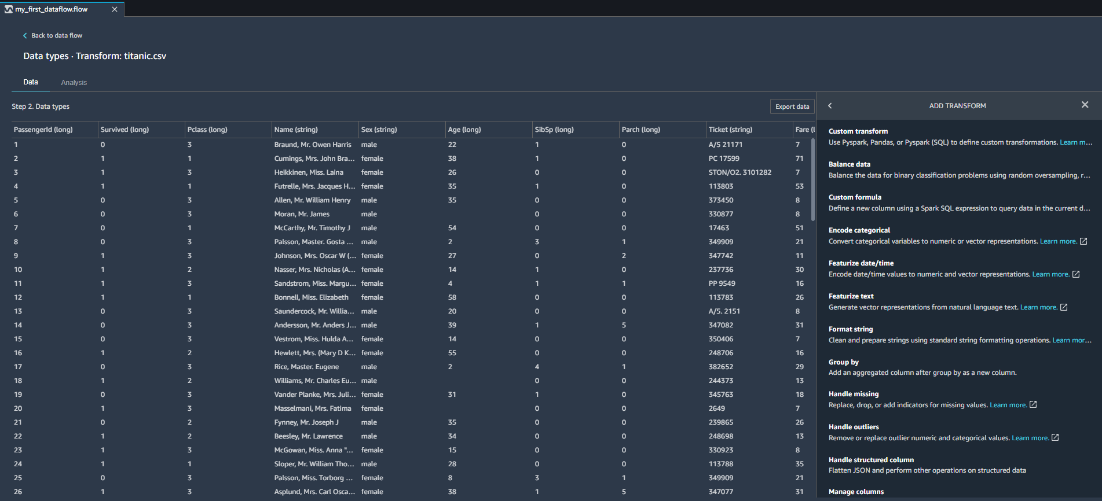
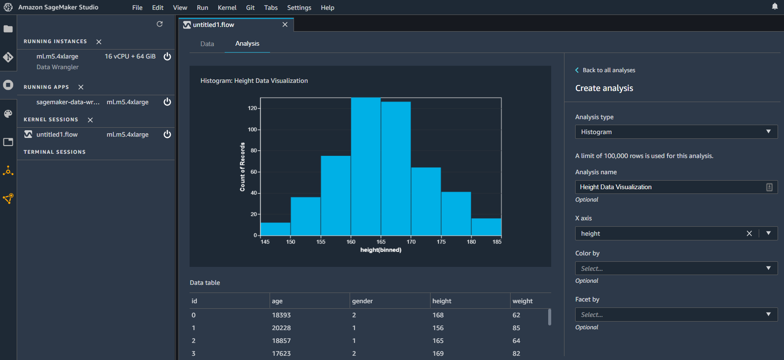
DATA WRANGLER 101
Amazon SageMaker Data Wrangler accelerates the process of data preparation, exploration, cleaning, visualization and feature engineering. It makes creating Extract, Transform and Load (ETL) pipelines much easier.

Slide 5
DATA WRANGLER 101
SageMaker Data Wrangler is cloud based and doesn’t require any code!
Data can be imported into data Wrangler from more than one source such as S3, RedShift and SageMaker Feature Store.
Data could be in CSV, database tables and Parquet formats.
Data Wrangler includes over 300 data transformations such as one hot encoding, normalization, imputation of missing data, ..etc.
Several data visualization templates are available to generate bar charts, line plots, histograms, scatterplots…etc.
Data Transformation workflows can be exported from data wrangler to a notebook or script so it can be automated with SageMaker Pipelines.
Check out success stories from customers: https://aws.amazon.com/sagemaker/data-wrangler/

Slide 6
FEATURE ENGINEERING 101
EASY
ADVANCED

Slide 7

WHAT IS FEATURE ENGINEERING?
Machine Learning algorithms require training data to train.
Feature engineering is a critical task that is performed by data scientists prior to training AI/ML models to ensure solid trained model performance.
Feature engineering is an art of introducing new features that weren’t existing before.
Data scientists spend 80% of their time performing feature engineering.
The remaining 20% is the easy part which includes training the model and performing hyperparameters optimization.
As a data scientist, you may need to:
Highlight important information in the data
Remove/isolate unnecessary information (e.x.: outliers).
Add your own expertise and domain knowledge to the alter the data.
Photo Credit: https://pixabay.com/illustrations/network-data-memory-data-collection-4478146/

Slide 8
FEATURE ENGINEERING: PROPER QUESTIONS TO ASK?
As a data scientist, you need to answer the following questions:
Which features should I select?
Can I add my domain knowledge to use less features?
Can I come up with new features from the data I have at hand?
What should I put in the missing data locations?
What are the capabilities of the ML model I have?
It is important to choose features that are most relevant to the problem.
Adding new features that are unnecessary will increase the computational requirements needed to train the model (curse of dimensionality).
There are many techniques that could be used to reduce the number of features (compress/encode the data) such as Principal Component Analysis (PCA) – will be covered later.

Slide 9
FEATURE ENGINEERING: QUIZ
Let’s take a look at this data and see what’s wrong with it!
CUSTOMER ID | CUSTOMER NAME | LOCATION | CLICK ON AD?
1 | Georgina | USA | Yes
2 | Leila | Canada | 1
3 | Sarah | France | 0
4 | Bird |  | 1
5 | Max | Netherlands | 0
6 | Sarah | France | 0

Slide 10
FEATURE ENGINEERING: SOLUTION
Let’s take a look at this data and see what’s wrong with it!
ENTIRE COLUMN REQUIRES ENCODING
MISSING INFORMATION
CUSTOMER ID | CUSTOMER NAME | LOCATION | CLICK ON AD?
1 | Georgina | USA | Yes
2 | Leila | Canada | 1
3 | Sarah | France | 0
4 | Bird |  | 1
5 | Max | Netherlands | 0
6 | Sarah | France | 0
REQUIRES FORMATTING
DUPLICATE ENTRY

Slide 11
FEATURE ENGINEERING TECHNIQUES
Imputation
Handling Outliers
Binning
Log Transform
One-Hot Encoding
Feature Split
Scaling

Slide 12
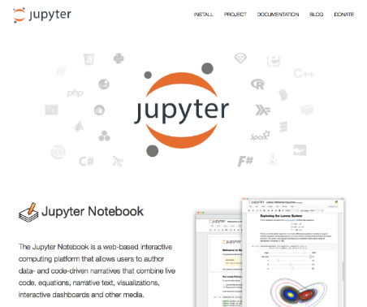


FEATURE ENGINEERING: TOOLS
JUPYTER NOTEBOOKS
AMAZON SAGEMAKER DATA WRANGLER
AWS GLUE

Slide 13
ONE-HOT ENCODING
EASY
ADVANCED

Slide 14
ONE-HOT ENCODING: WHY DO WE NEED IT?
Can we simply replace colors with integer values?
The machine learning model will assume that:
$$GREEN>YELLOW>RED$$
COLOR
RED
RED
YELLOW
GREEN
YELLOW
ENCODED COLOR
1
1
2
3
2
WRONG!

Slide 15
ONE-HOT ENCODING
One hot encoding is widely used in machine learning.
It works by converting values such as “color” into columns with 1’s and 0’s in them.
Since machine learning models deal with numbers, we perform one hot encoding to convert from categorical data into numerical.
If you have N categories, you will need N-1 binary columns to represent them.
COLOR
RED
RED
YELLOW
GREEN
YELLOW
RED | YELLOW | GREEN
1 | 0 | 0
1 | 0 | 0
0 | 1 | 0
0 | 0 | 1
0 | 1 | 0

Slide 16

ONE-HOT ENCODING: ORDINAL Vs. NOMINAL
The difference between nominal and ordinal data is as follows:
In ordinal data, order is important.
In nominal data, order is not important.
NOMINAL
Order of colors doesn’t mean anything!
ORDINAL
Order is important!
COLOR
RED
RED
YELLOW
GREEN
YELLOW
1 star means poor quality course
5 star means great quality course
Photo Credit: https://pixabay.com/vectors/rating-stars-system-evaluation-153125/

Slide 17
SCALING: NORMALIZTION & STANDARDIZATION
EASY
ADVANCED

Slide 18
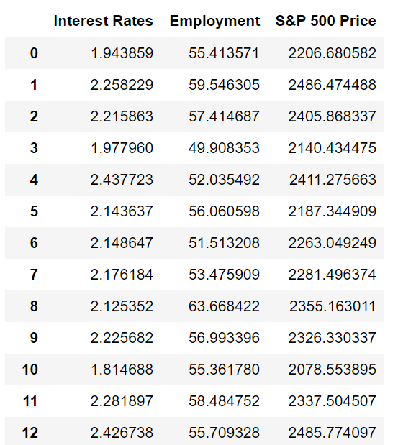
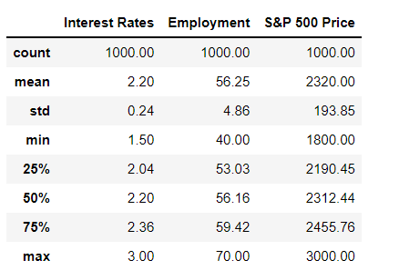
FEATURE SCALING
Feature Scaling is an important step to take prior to training of machine learning models to ensure that features are within the same scale.
Example: interest rate and employment score are at a different scale. This will result in one feature dominating the other feature.
Scikit Learn offers several tools to perform feature scaling.
RAW ORIGINAL DATASET
QUICK STATS!

Slide 19
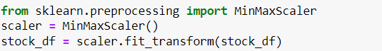
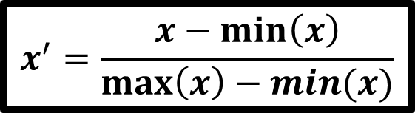
NORMALIZATION
Normalization is conducted to make feature values range from 0 to 1.
$$x^{′}=\frac{x−\min\left(x\right)}{\max\left(x\right)−min⁡(x)}$$

Slide 20
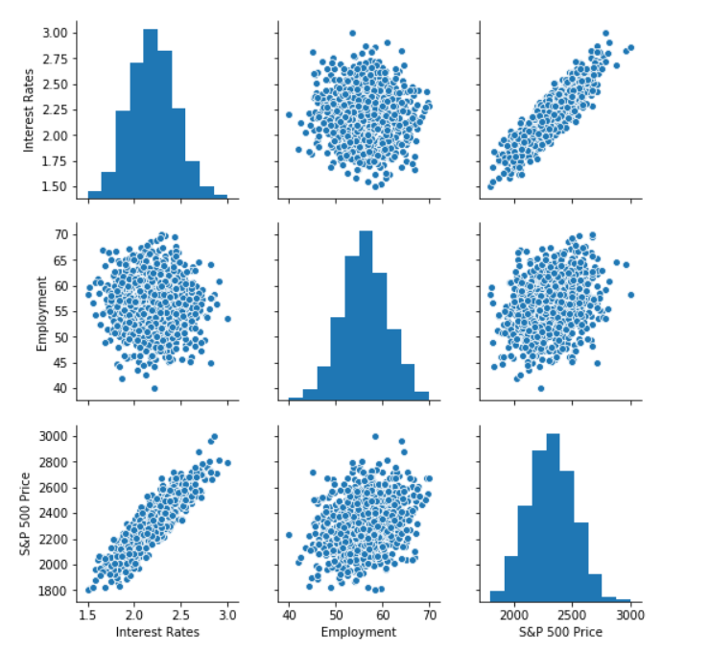
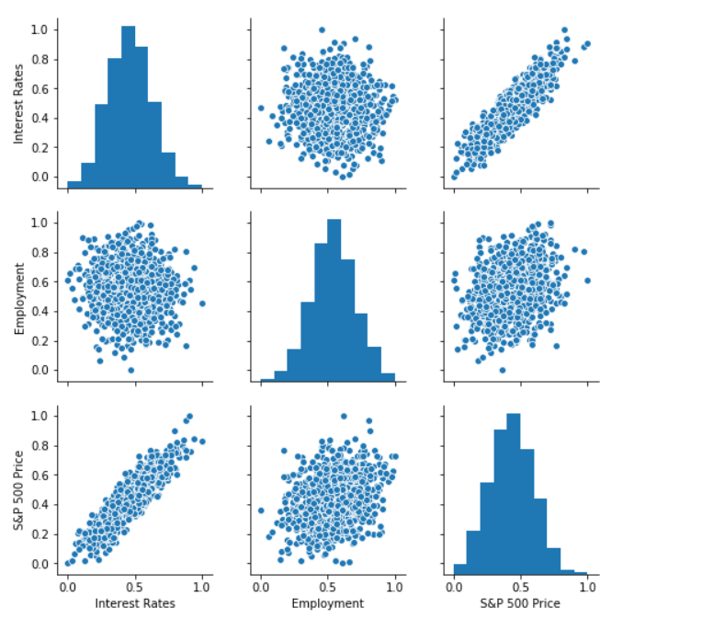
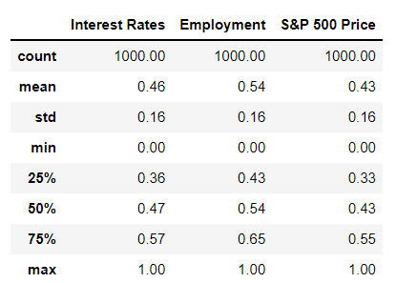
NORMALIZATION
Normalization is conducted to make feature values range from 0 to 1.

Slide 21
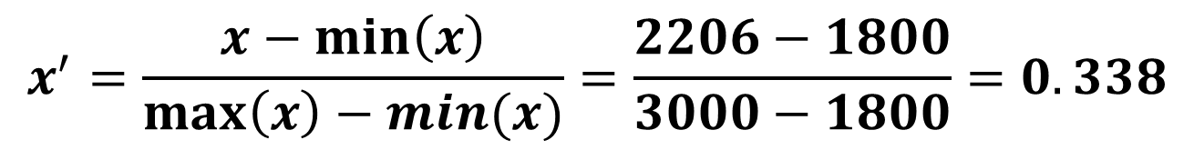
NORMALIZATION
$$x^{′}=\frac{x−\min\left(x\right)}{\max\left(x\right)−min⁡(x)}=\frac{2206−1800}{3000−1800}=0.338$$
S&P 500 PRICE (ORIGINAL)
2206
2319
3000
1800
S&P 500 PRICE (NORMALIZED)
0.338
0.432
1
0
NOTE THAT NUMBERS NOW RANGE FROM 0 TO 1 AFTER NORMALIZATION
Randomly selected Value
NORMALIZATION/
SCALING
Average
Maximum
S&P 500 PRICE (Max) = 3000
S&P 500 PRICE (Min) = 1800
Minimum

Slide 22
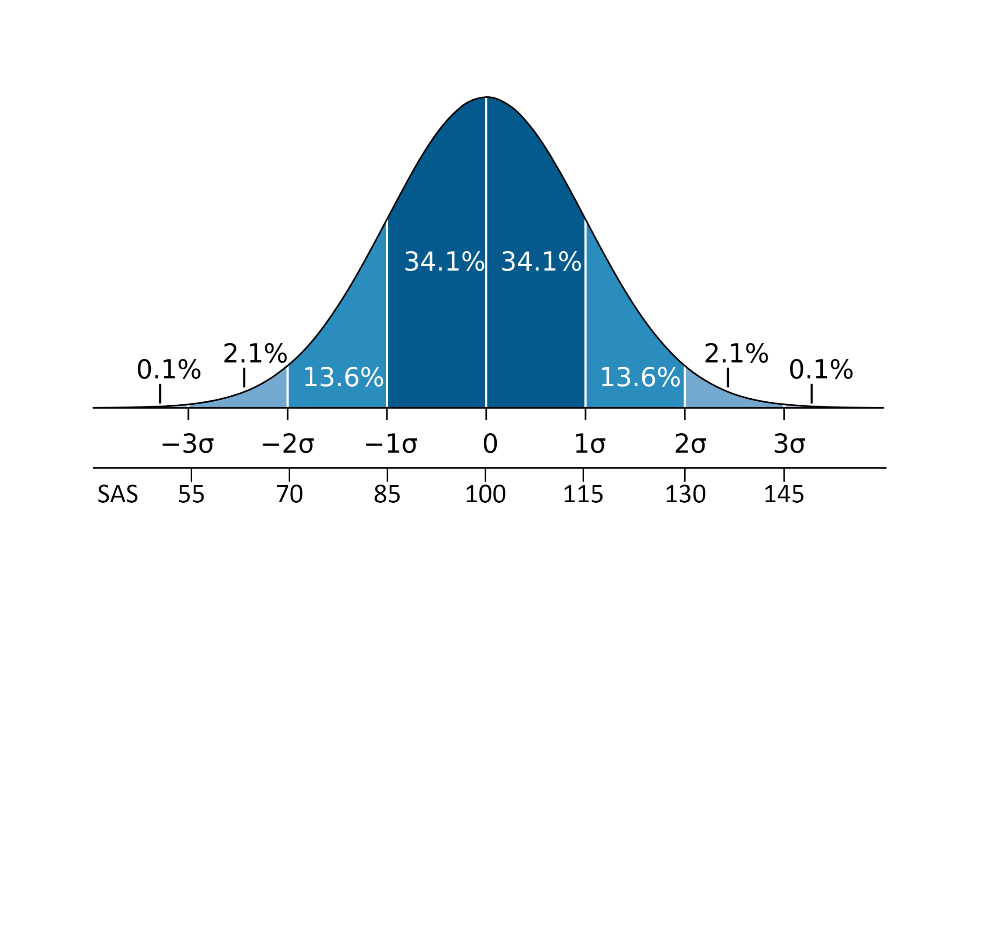
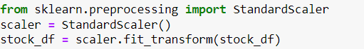
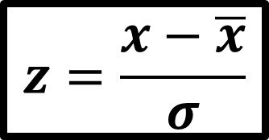
STANDARDIZATION
Standardization is conducted to transform the data to have a mean of zero and standard deviation of 1.
Standardization is also known as Z-score normalization in which properties will have the behaviour of a standard normal distribution.
$$z=\frac{x−\overline{x}}{σ}$$
Image Source: https://commons.wikimedia.org/wiki/File:Wechsler.svg

Slide 23
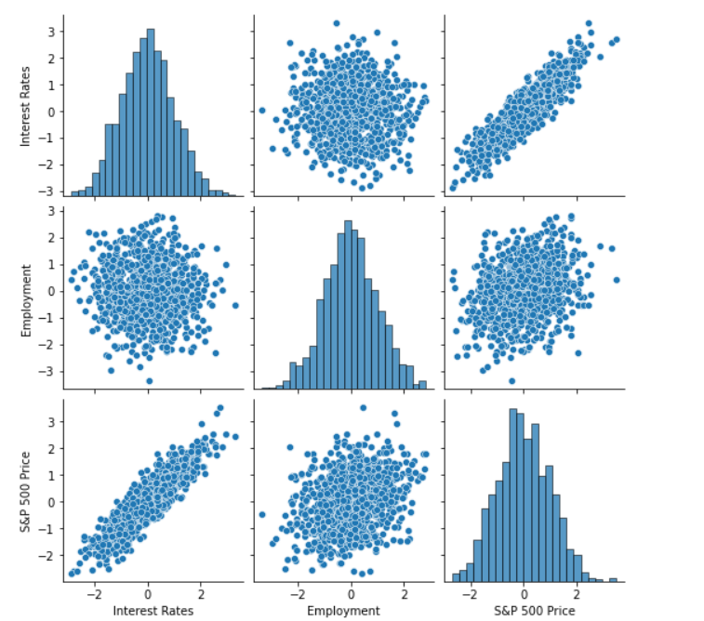
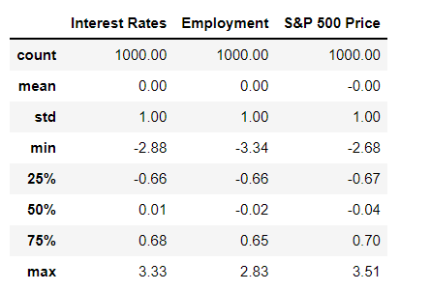
STANDARDIZATION
Standardization transforms data to have a mean of zero and standard deviation of 1.

Slide 24
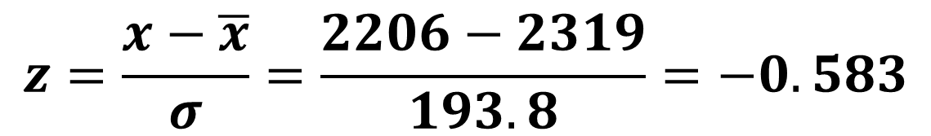
STANDARDIZATION
$$z=\frac{x−\overline{x}}{σ}=\frac{2206−2319}{193.8}=−0.583$$
NOTE THAT AFTER STANDARDIZATION THE AVERAGE IS SET TO ZERO
S&P 500 PRICE (ORIGINAL)
2206
2319
3000
1800
S&P 500 PRICE (STANDARIZED)
-0.583
0
3.513
-2.67
Randomly selected Value
STANDARIZATION
Average
Maximum
S&P 500 PRICE (Mean) = 2319
S&P 500 PRICE (Std) = 193.8
Minimum

Slide 25
ALWAYS REMEMBER!
“A normalized dataset will always range from 0 to 1”
“A standardized dataset will always have a mean of 0 and standard deviation of 1, but can have any upper and lower values”

Slide 26
WHEN SHOULD I PERFORM STANDARDIZATION VS. NORMALIZATION?
Scaling (standardization or normalization) is required when we use any machine learning algorithm that require gradient calculation.
Examples of machine learning algorithms that require gradient calculations are: linear/logistic regression and artificial neural networks
Having different scales for each feature will result in a different step size which in turn jeopardizes the process of reaching a minimum point.
Scaling is not required for distance-based and tree-based algorithms such as K-Means Clustering, Support Vector Machines and K Nearest Neighbors, decision trees, random forest, and XG-Boost.

Slide 27
STANDARDIZATION Vs. NORMALIZATION?
Generally speaking, there is no right or wrong answer!
In case of neural networks, normalization is preferred since we don’t assume any data distribution.
Standardization is preferred when data follows gaussian distribution
Standardization is preferred over normalization when there are a lot of outliers.

Slide 28
DATA WRANGLER DEMO #1: LAUNCHING & UPLOADING DATA TO S3
EASY
ADVANCED

Slide 29
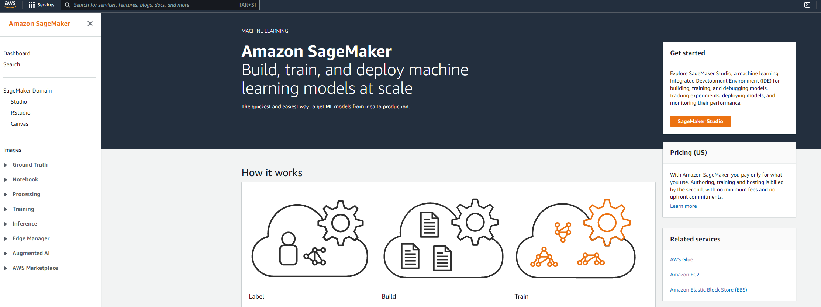
DATA WRANGLER DEMO
GO TO SAGEMAKER HOMEPAGE

Slide 30
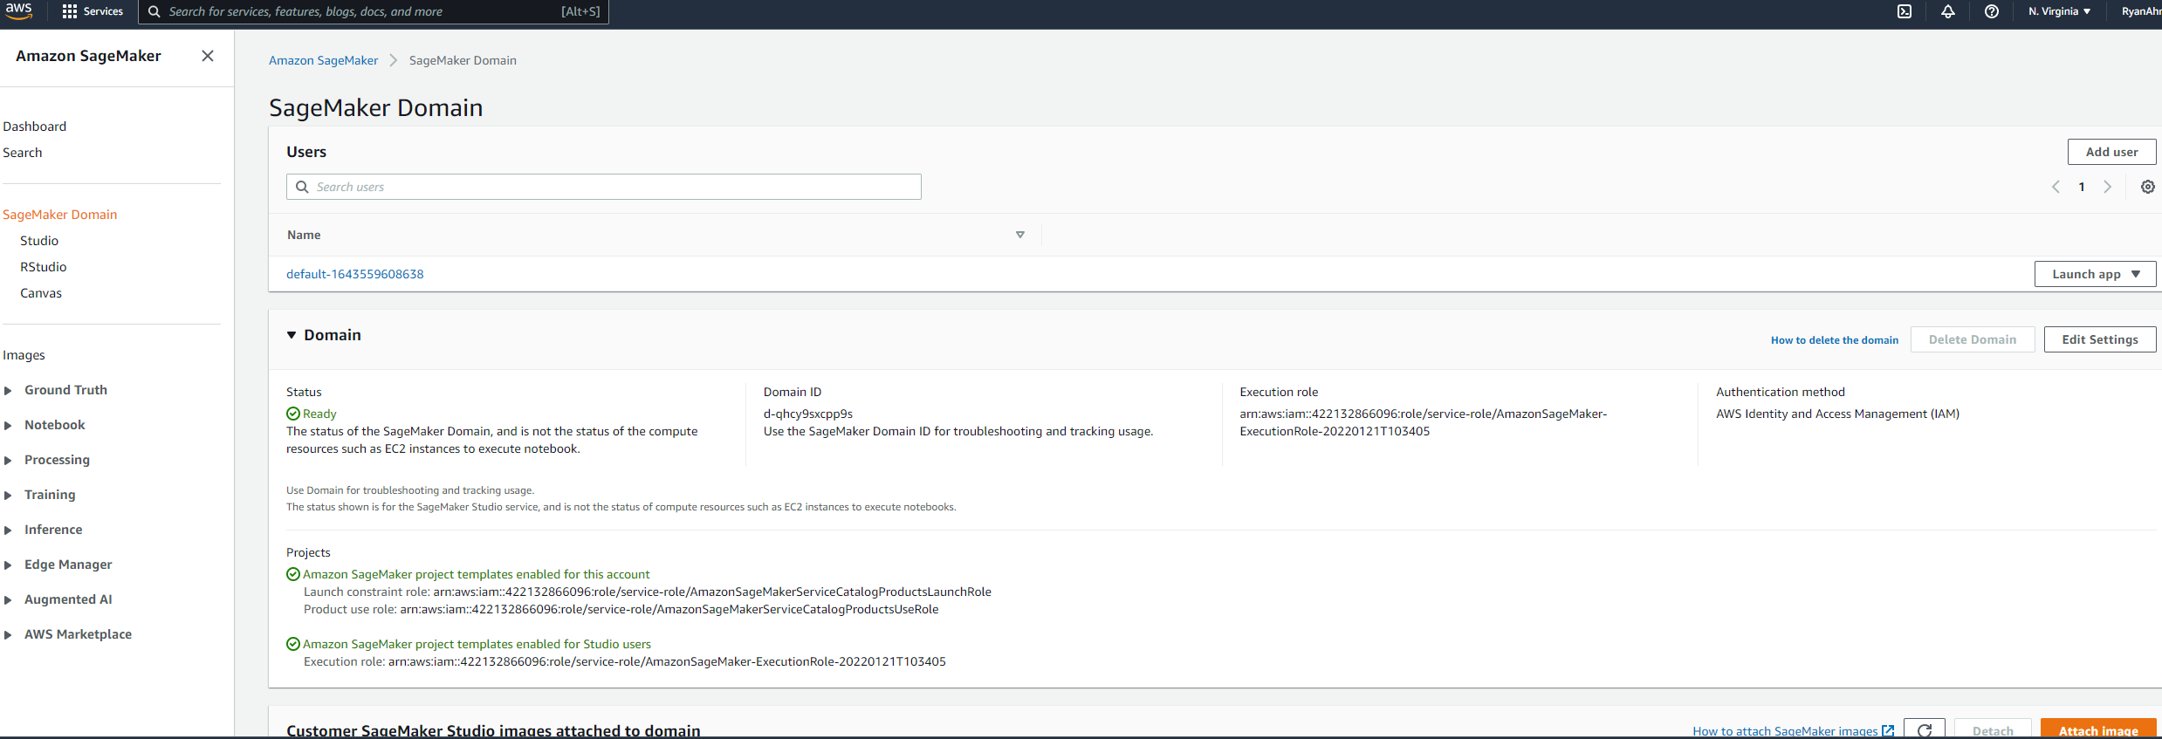
DATA WRANGLER DEMO
CLICK ON LAUNCH APP

Slide 31
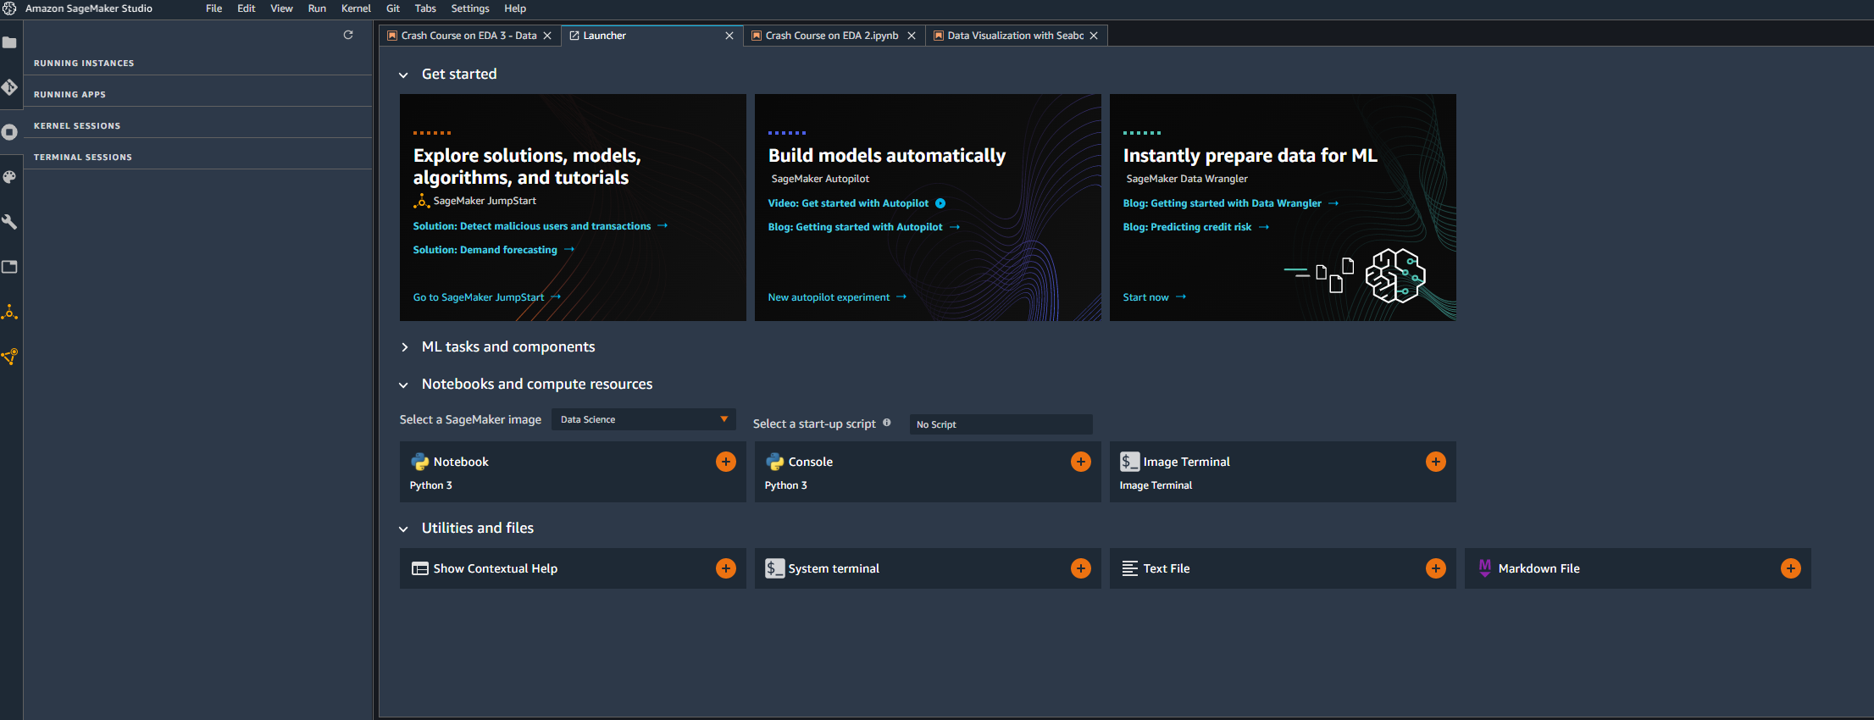
DATA WRANGLER DEMO
CLICK ON INSTANTLY PREPARE DATA FOR ML WITH DATA WRANGLER

Slide 32
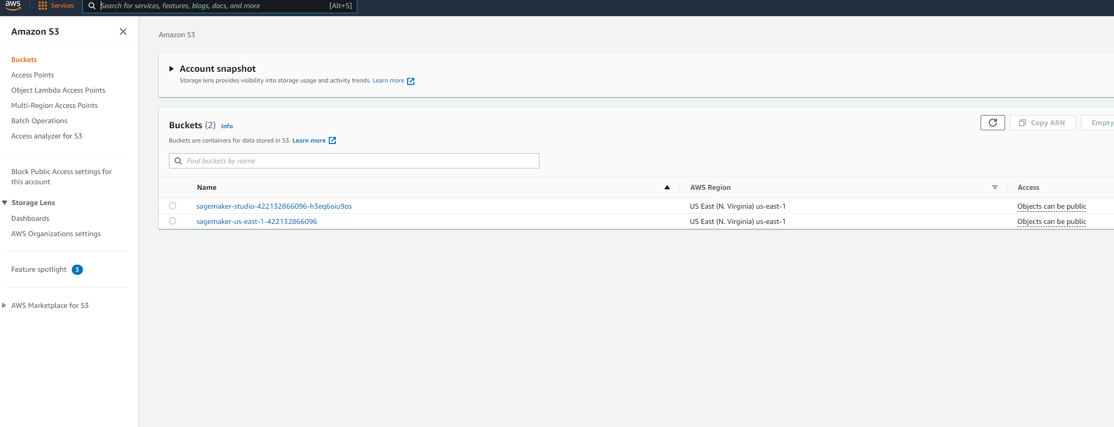
DATA WRANGLER DEMO
LET’S UPLOAD THE DATA TO S3.
GO TO S3 AND NAVIGATE TO THE SAGEMAKER STUDIO BUCKET.

Slide 33
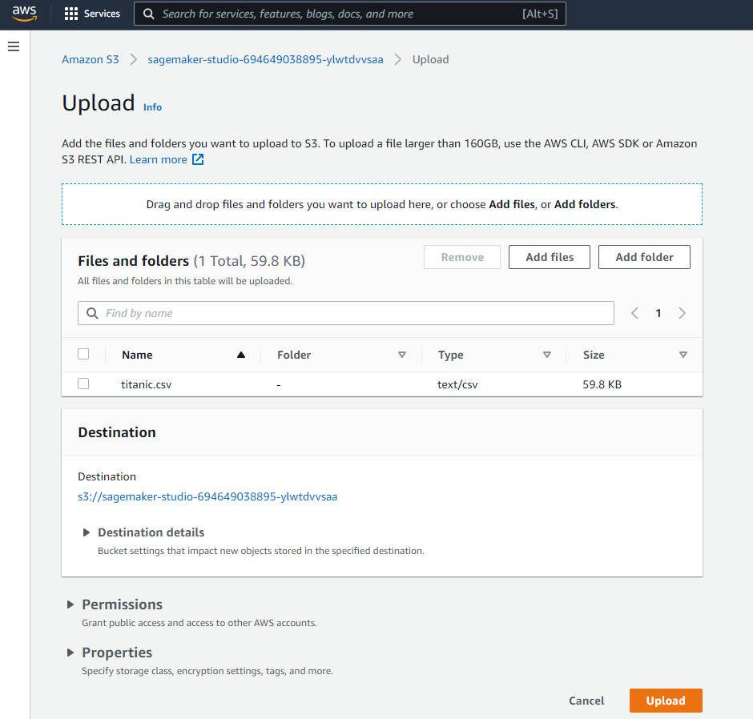
DATA WRANGLER DEMO
DRAG AND DROP TITANIC.CSV to S3

Slide 34
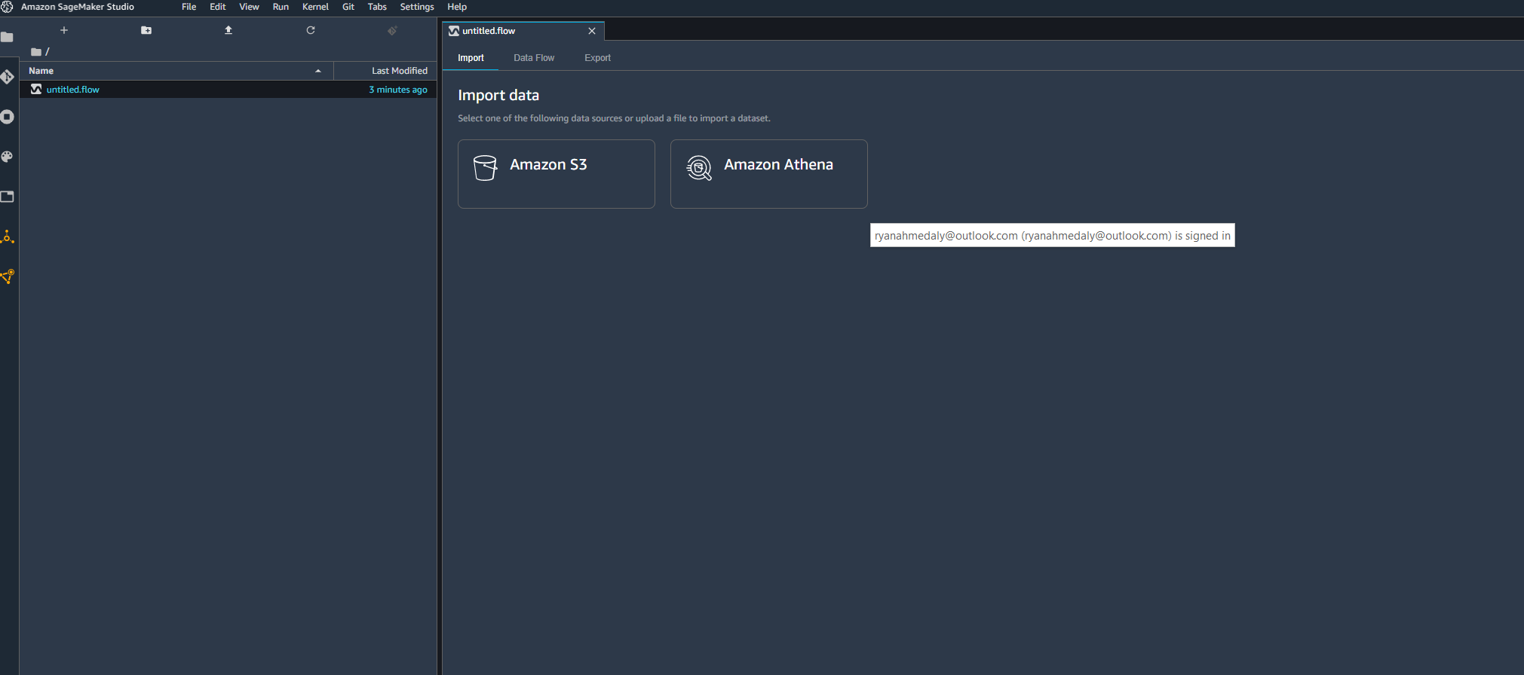
DATA WRANGLER DEMO
SELECT DATA FROM S3

Slide 35
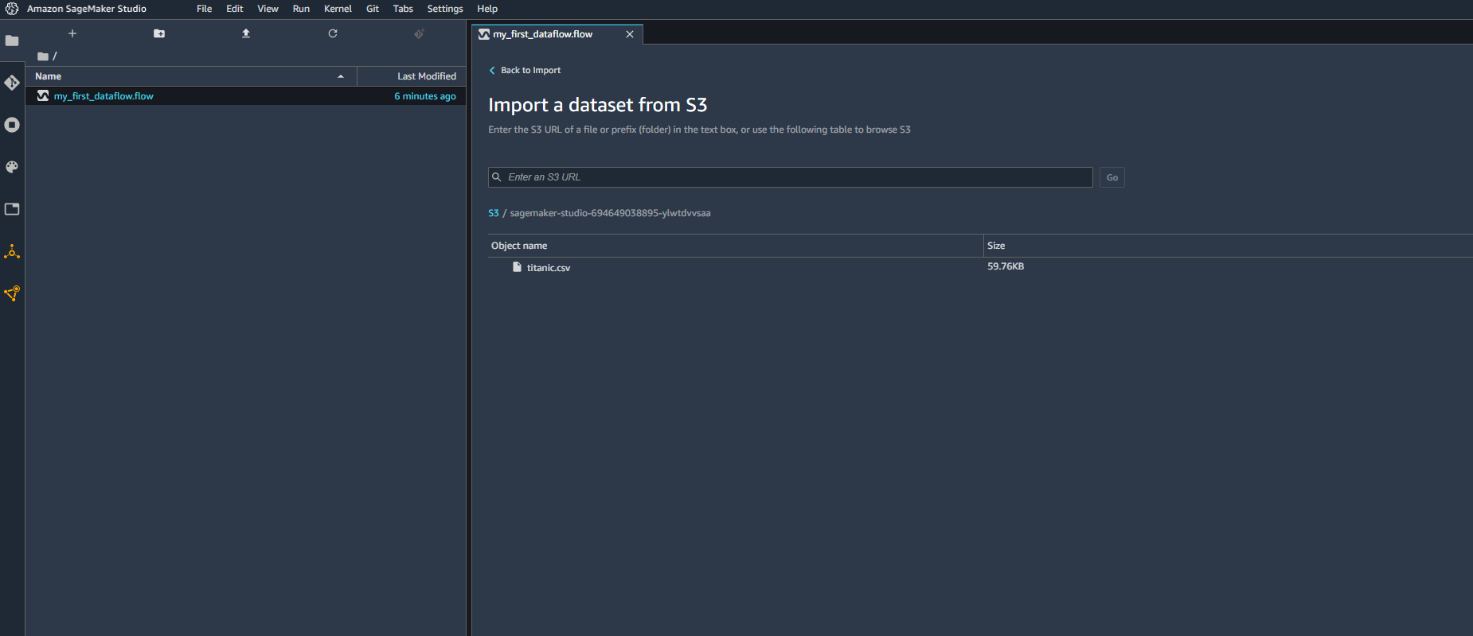
DATA WRANGLER DEMO
CLICK ON S3 AND SELECT THE DATASET YOU RECENTLY UPLOADED TO S3

Slide 36
DATA WRANGLER DEMO #2: PERFORM EDA (CHANGE DATA TYPE & SUMMARY)
EASY
ADVANCED

Slide 37
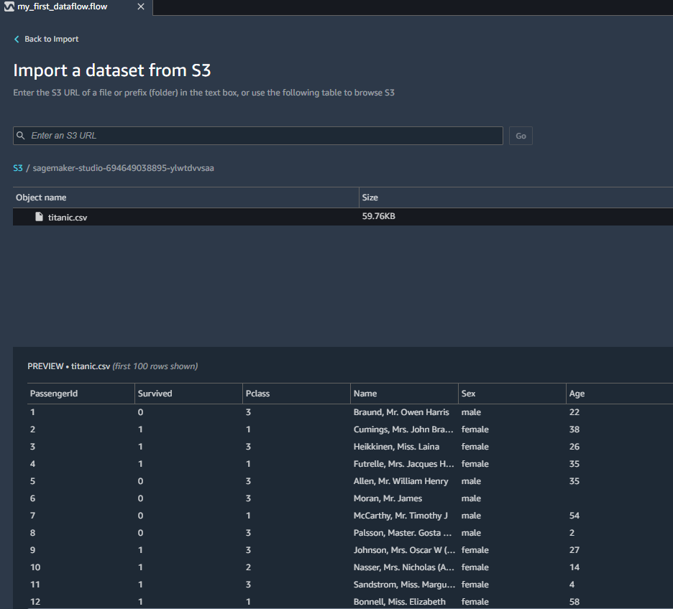
DATA WRANGLER DEMO
YOU SHOULD SEE THE PREVIEW OF THE DATASET BELOW, CLICK IMPORT!

Slide 38
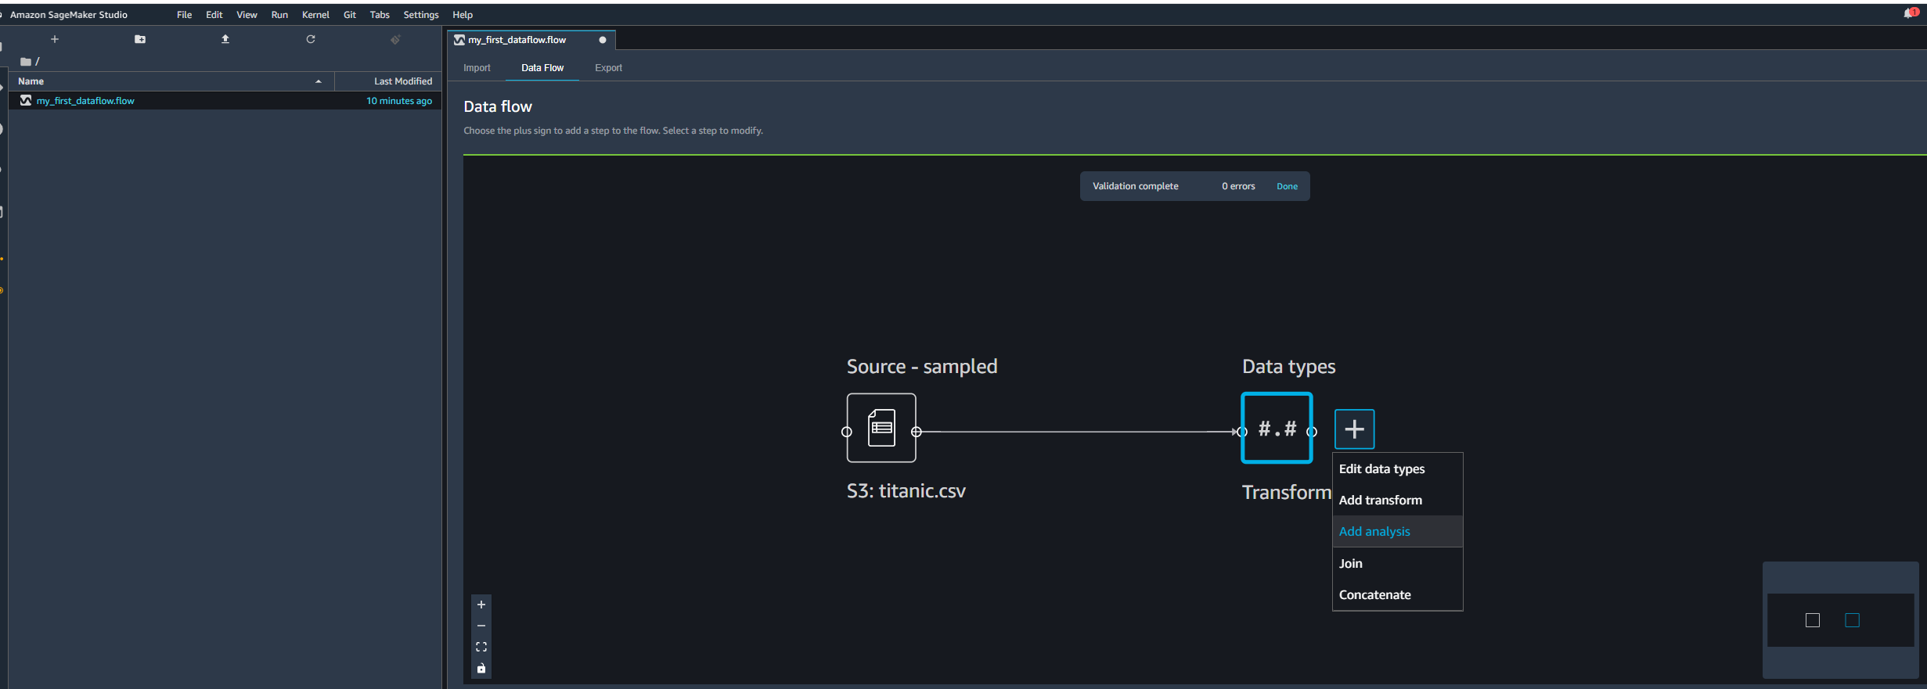
DATA WRANGLER DEMO
YOU SHOULD SEE THE DATA FLOW, CLICK ON THE “+” NEXT TO TRANSFORM

Slide 39
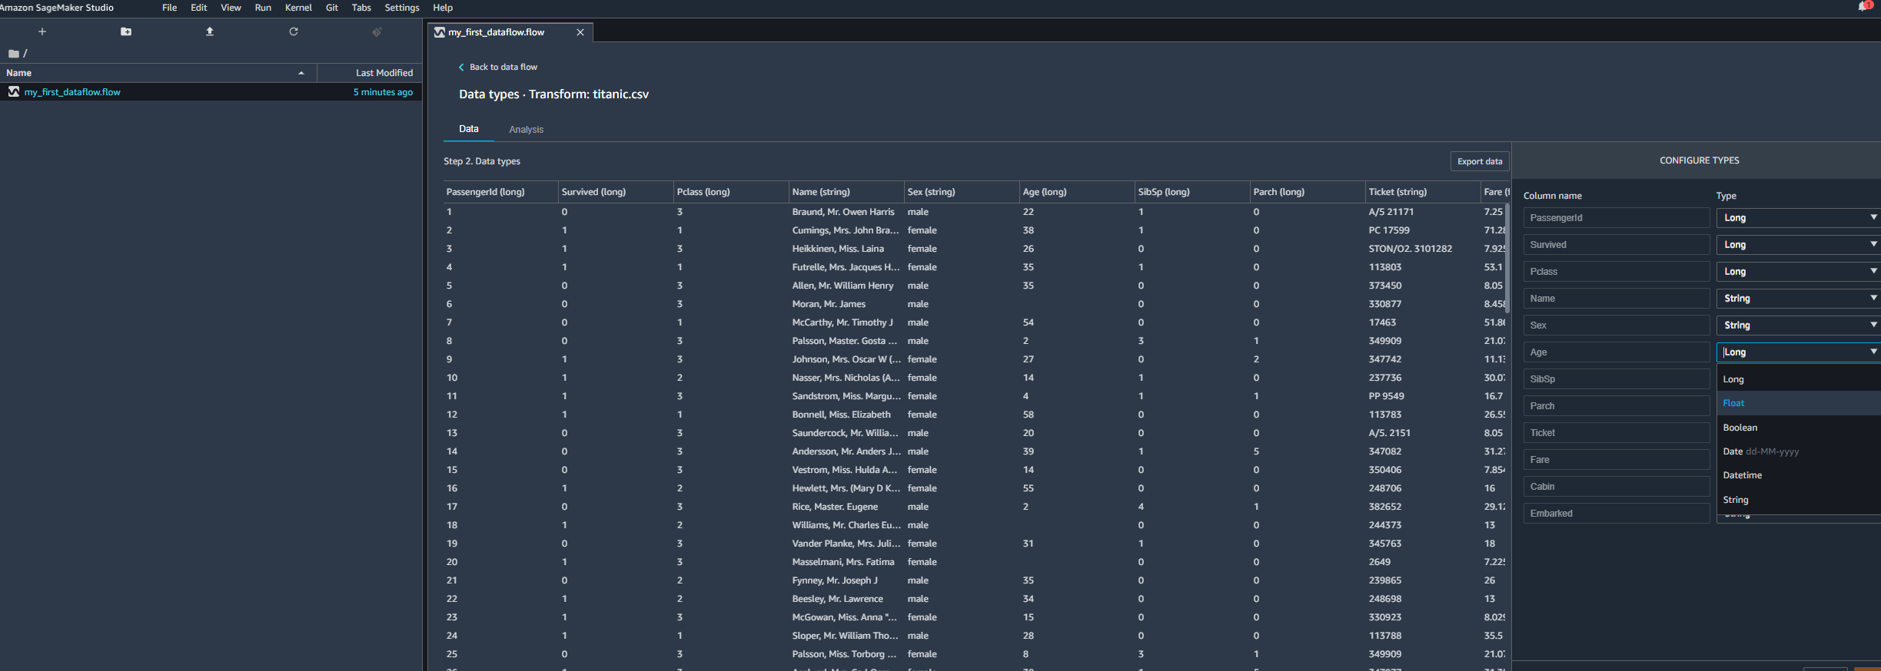
DATA WRANGLER DEMO
YOU CAN EASILY EDIT DATATYPES IN DATA WRANGLER. LET’S CHANGE THE FARE FROM “FLOAT” TO “LONG”. NOTE THAT LONG IS A LARGER DATA TYPE THAN INTEGER. INT IS 32 BITS IN WIDTH WHILE LONG IS 64 BITS. YOU CAN PREVIEW THE CHANGE AND ACCEPT IT

Slide 40
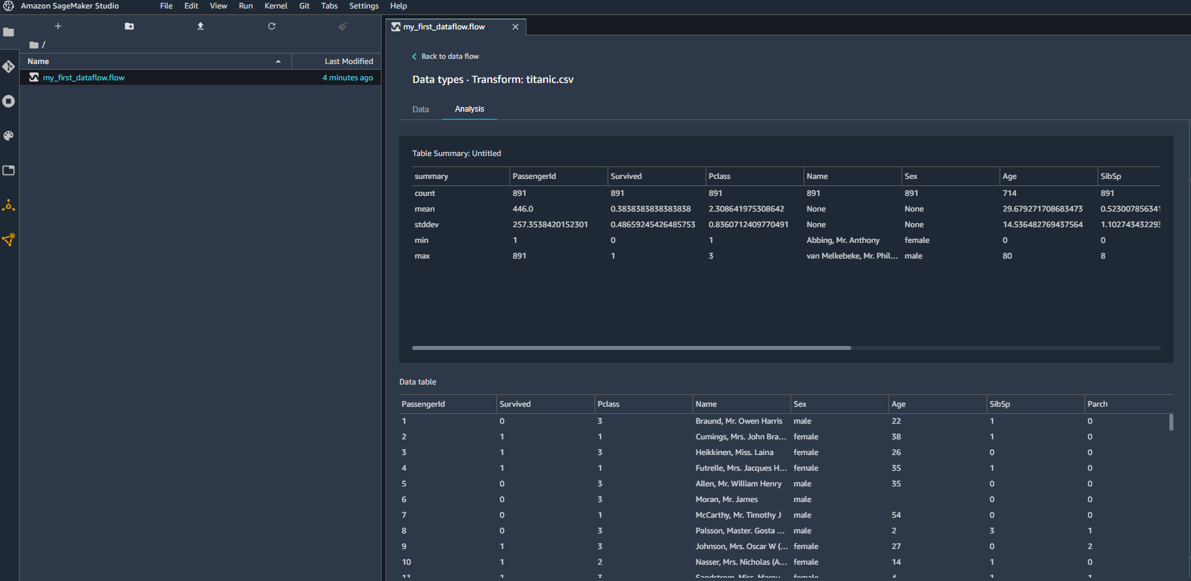
DATA WRANGLER DEMO
LET’S SEE IF WE HAVE MISSING DATA AND PRINT OUT A STATISCAL SUMMARY SIMILAR TO THE .describe() method. CLICK ON ANALYSIS>TABLE SUMMARY
NOTE THAT WE HAVE MISSING DATA IN “AGE” AND “CABIN”

Slide 41
DATA WRANGLER DEMO #3: PERFORM DATA VISUALIZATION
EASY
ADVANCED

Slide 42
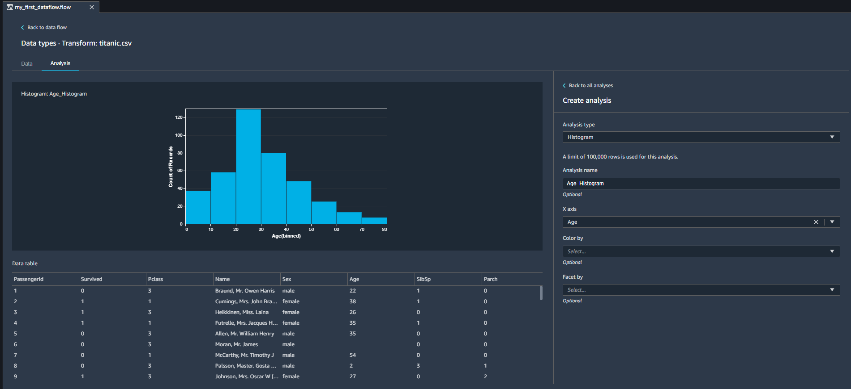
DATA WRANGLER DEMO
LET’S PLOT THE HISTOGRAM OF THE AGE COLUMN

Slide 43
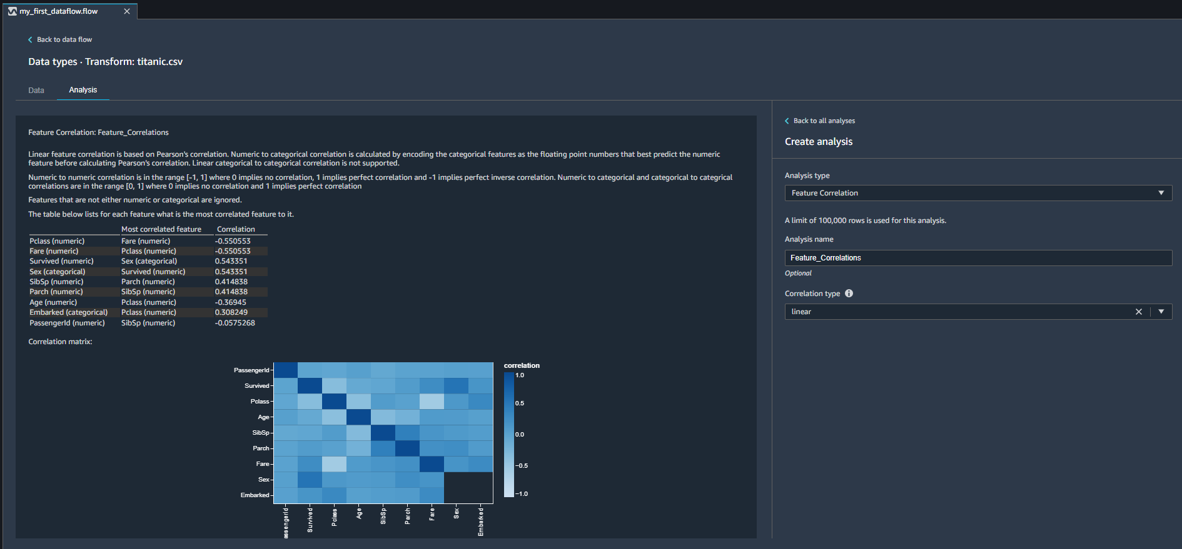
DATA WRANGLER DEMO
LET’S PLOT CORRELATIONS

Slide 44
DATA WRANGLER DEMO #4: DUPLICATES, BIAS, AND FEATURE IMPORTANCE
EASY
ADVANCED

Slide 45
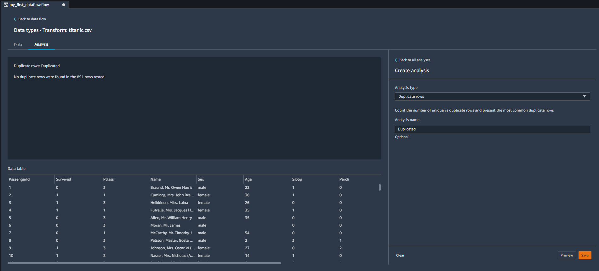
DATA WRANGLER DEMO
LET’S SEE IF THERE ARE ANY DUPLICATED ROWS

Slide 46
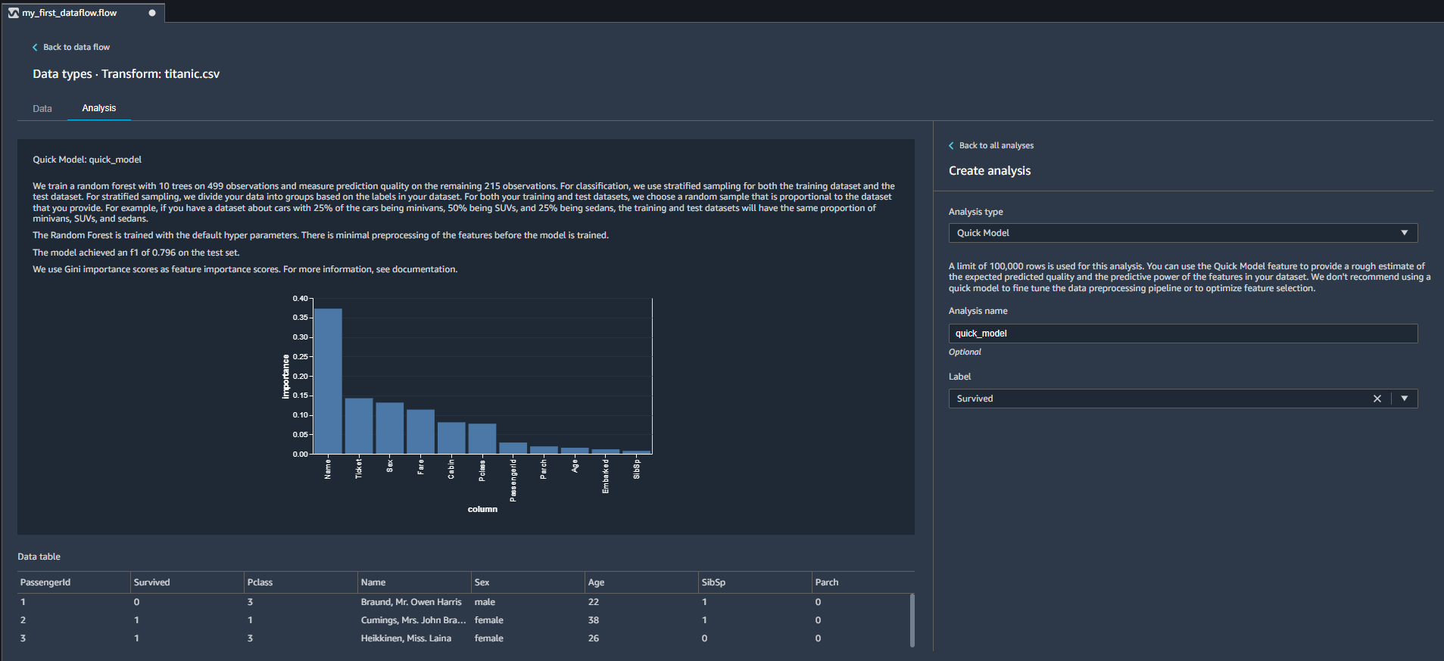
DATA WRANGLER DEMO
LET’S GET A QUICK MODEL AND PLOT FEATURE IMPORTANCE

Slide 47
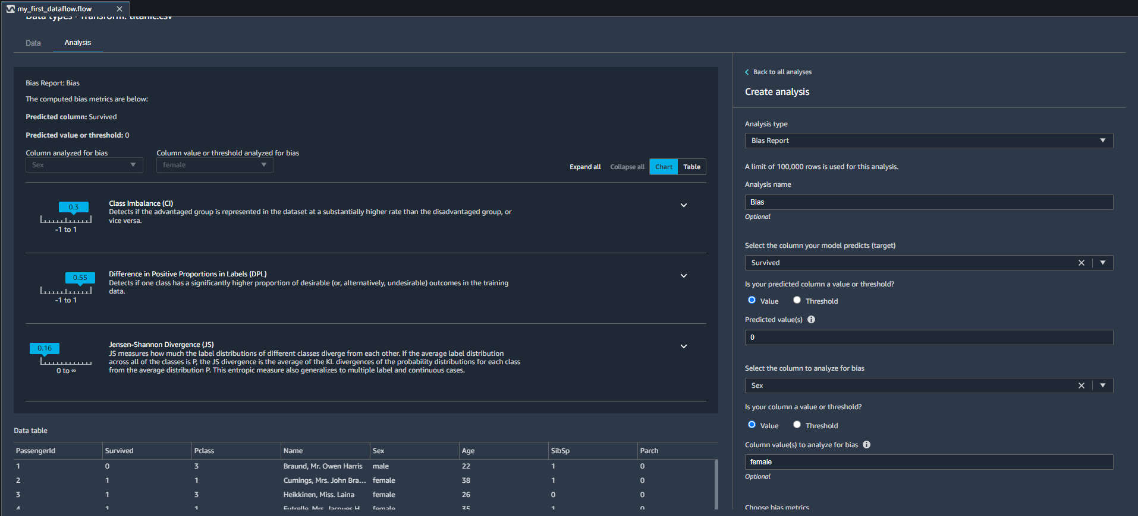
DATA WRANGLER DEMO
CHECK FOR DATA BIAS – UNBALANCED DATASETS

Slide 48
DATA WRANGLER DEMO #5: TRANSFORMATIONS (IMPUTE, DROP, & ENCODING)
EASY
ADVANCED

Slide 49
DATA WRANGLER DEMO
CLICK ON ADD TRANSFORM AND SELECT FROM 300+ TRANSFORMATIONS!!

Slide 50
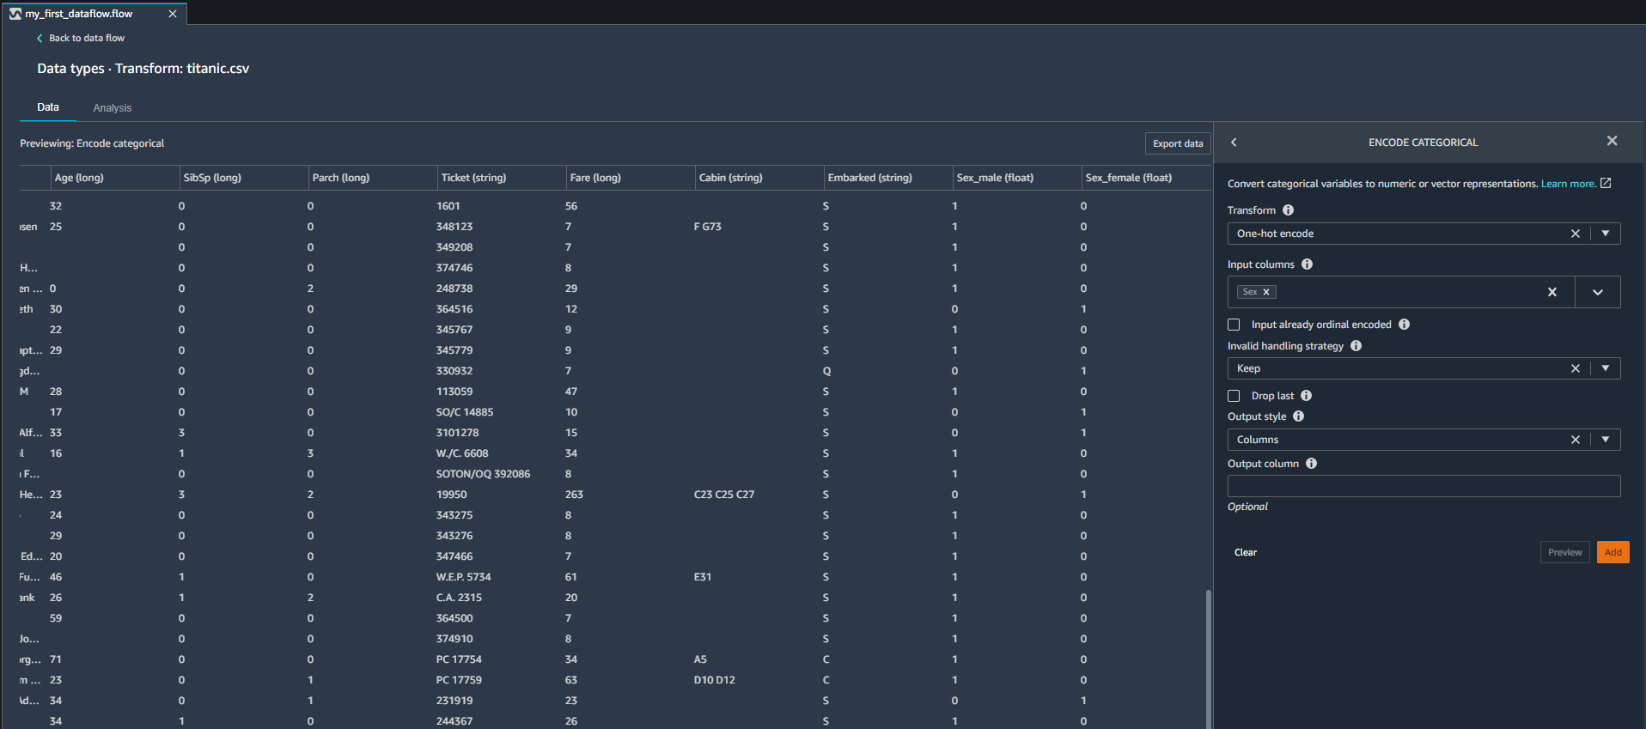
DATA WRANGLER DEMO
SELECT ONE HOT ENCODING FOR THE SEX COLUMN

Slide 51
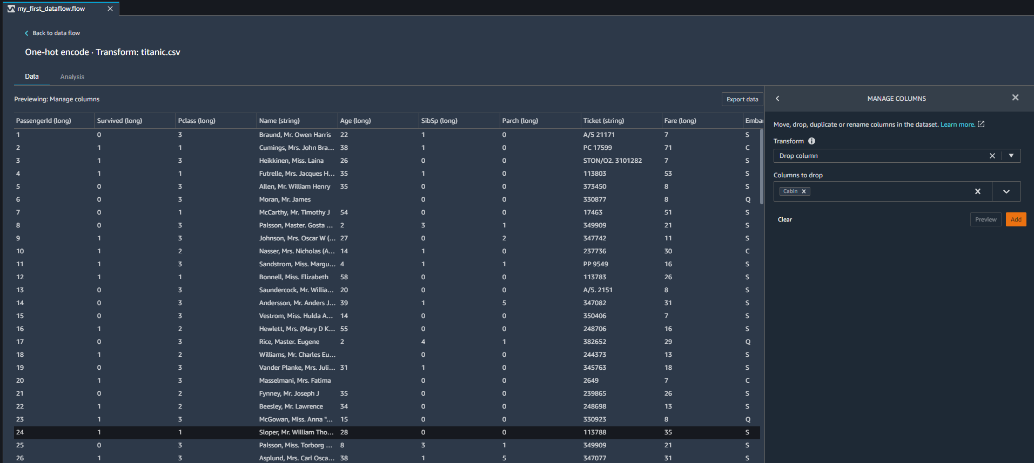
DATA WRANGLER DEMO
LET’S DROP THE CABIN COLUMN

Slide 52
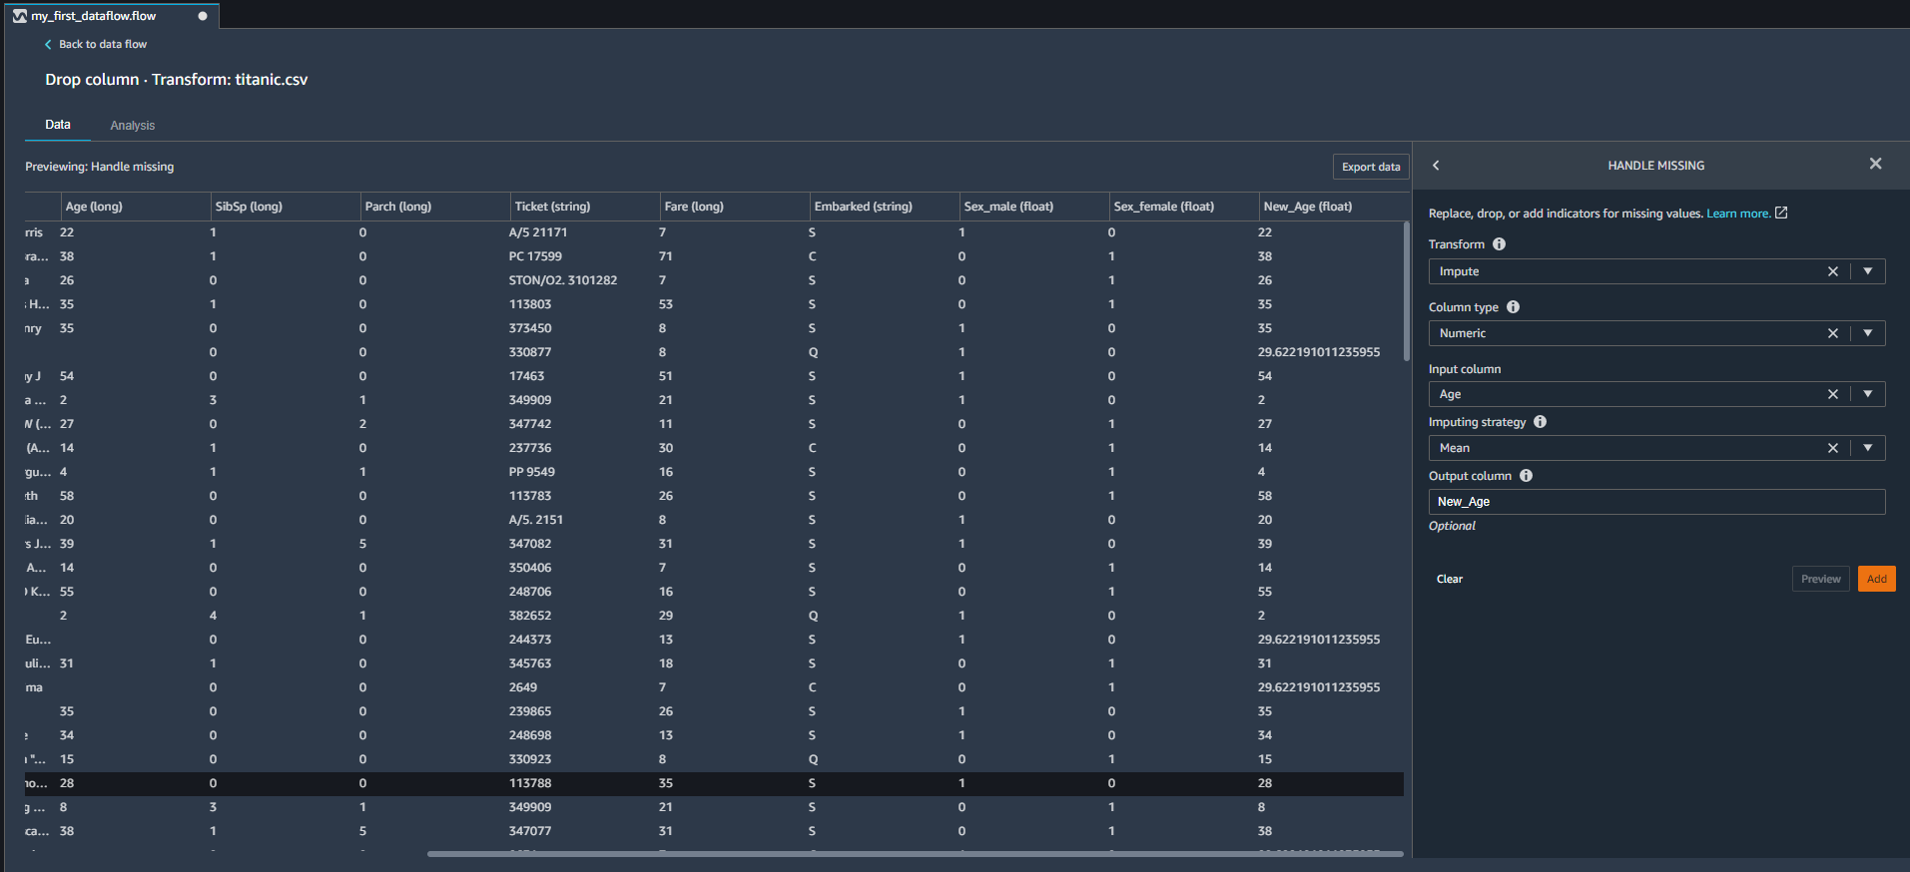
DATA WRANGLER DEMO
FILL OUT MISSING AGE VALUES

Slide 53
DATA WRANGLER DEMO #6: TRANSFORMATIONS (CUSTOM TRANSFORM & SCALING)
EASY
ADVANCED

Slide 54
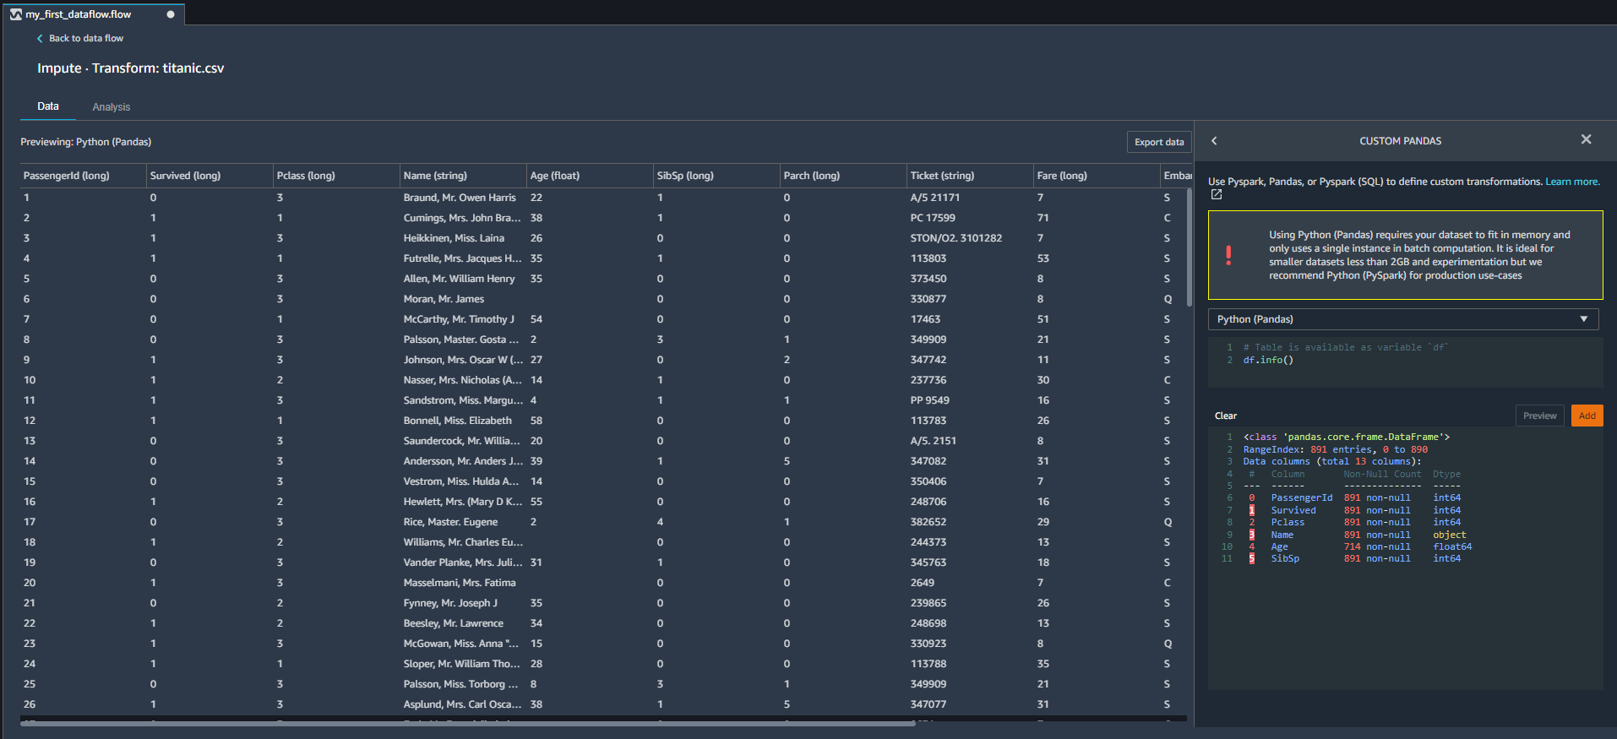
DATA WRANGLER DEMO
INTEGRATE A CUSTOM-BASED info() METHOD INTO THE WORKFLOW

Slide 55
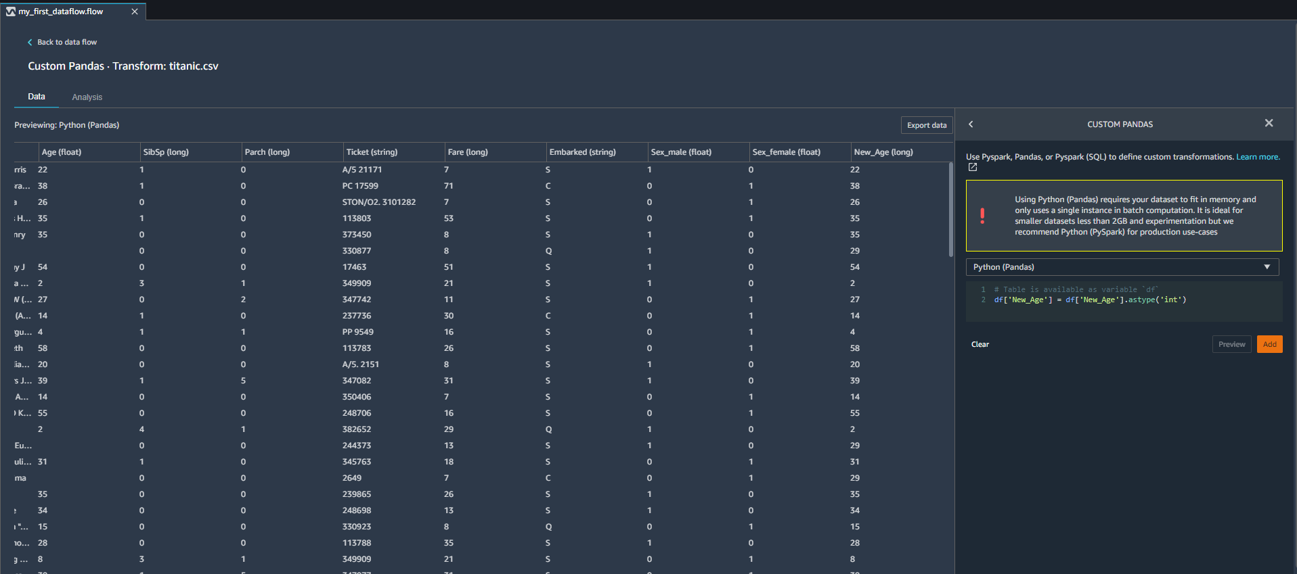
DATA WRANGLER DEMO
LET’S CHANGE THE DATATYPE USING CODE!

Slide 56
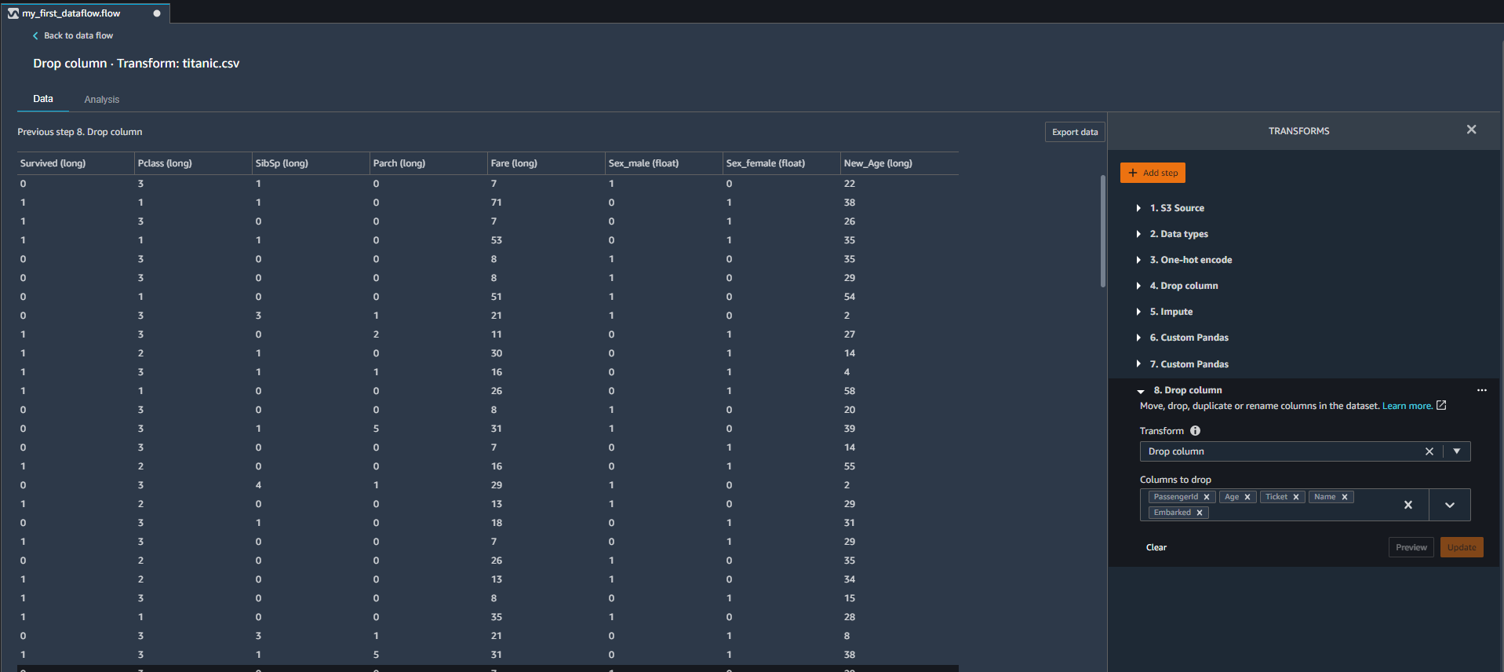
DATA WRANGLER DEMO
LET’S DROP THE PASSENGER ID, EMBARKED, TICKET NUMBER, NAME AND THE AGE (NOTE THAT WE HAVE A NEW_AGE COLUMN AFTER WE FILLED OUT MISSING ROWS!

Slide 57
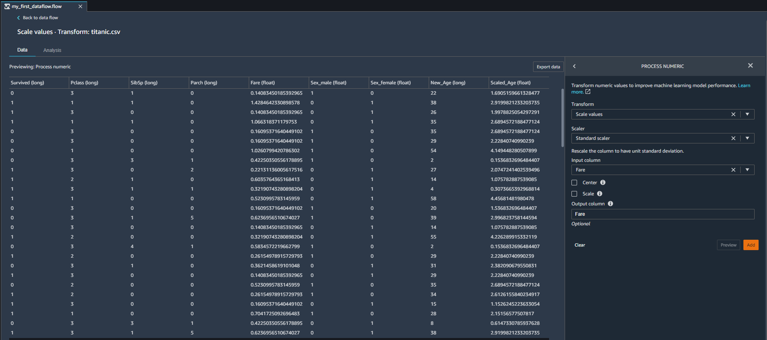
DATA WRANGLER DEMO
LET’S PERFORM STANDARD SCALER WHICH WILL TRANSFORM NUMERIC DATA INTO ZERO MEAN. NOTE THAT YOU CAN OVERRIDE THE ORIGINAL COLUMN NAME

Slide 58
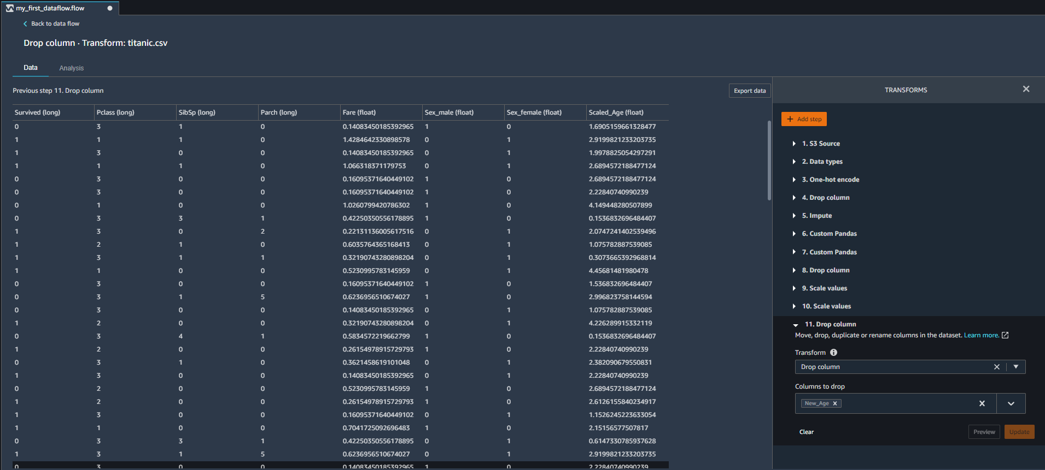
DATA WRANGLER DEMO
LET’S DROP THE AGE, NOTE THAT WE COULD HAVE REMOVED THIS STEP IF WE PUT THE OUTPUT COLUMN NAME SIMILAR TO THE INPUT

Slide 59
DATA WRANGLER DEMO
ONE LAST STEP! NOTE THAT SEX_FEMALE AND SEX_MALE ARE NEGATIVELY CORRELATED. DROP ONE OF THEM BEFORE YOU TRAIN YOUR MACHINE LEARNING MODEL

Slide 60
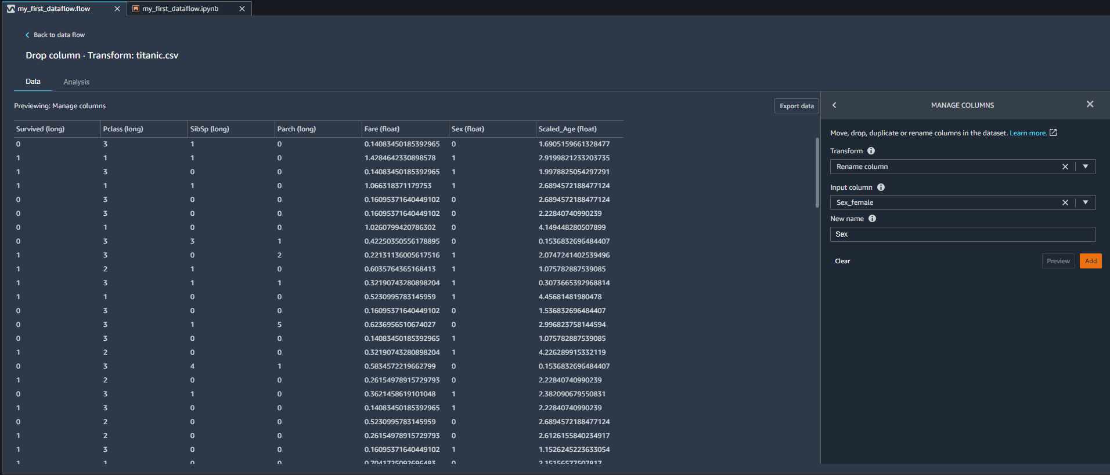
DATA WRANGLER DEMO
RENAME COLUMN

Slide 61
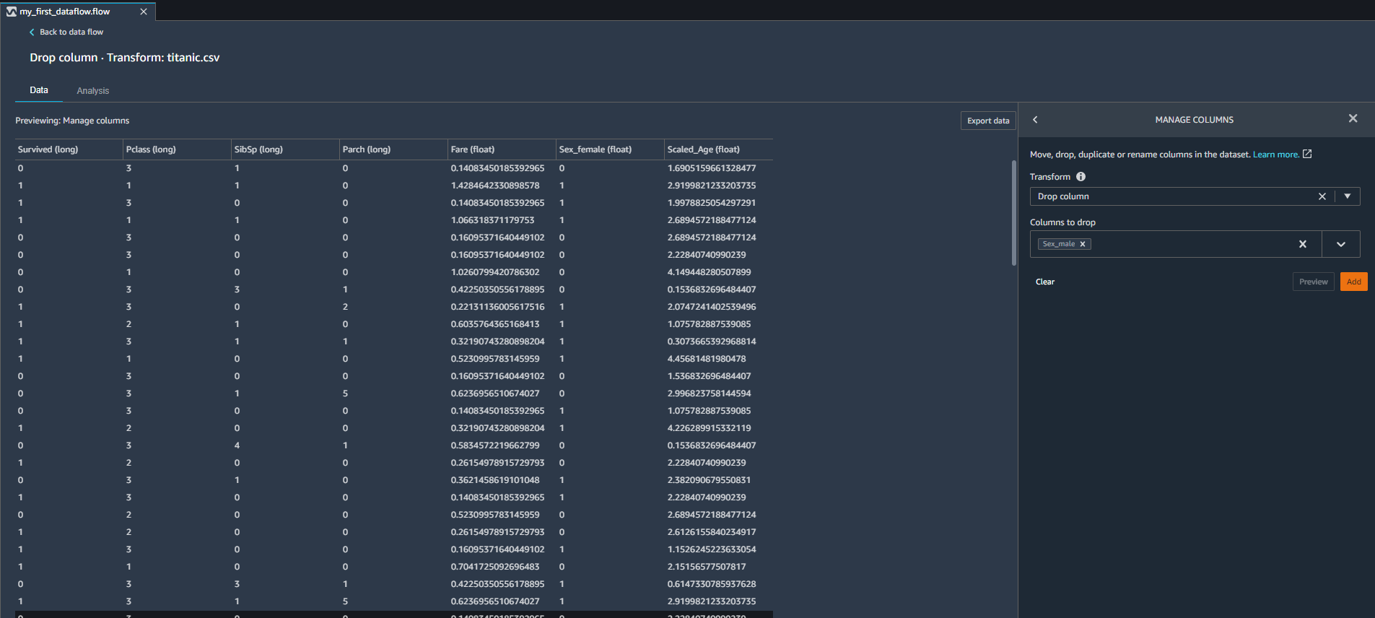
DATA WRANGLER DEMO
NOW YOU’RE GOOD TO GO!

Slide 62
DATA WRANGLER DEMO #7:
EXPORT WORKFLOW
EASY
ADVANCED

Slide 63
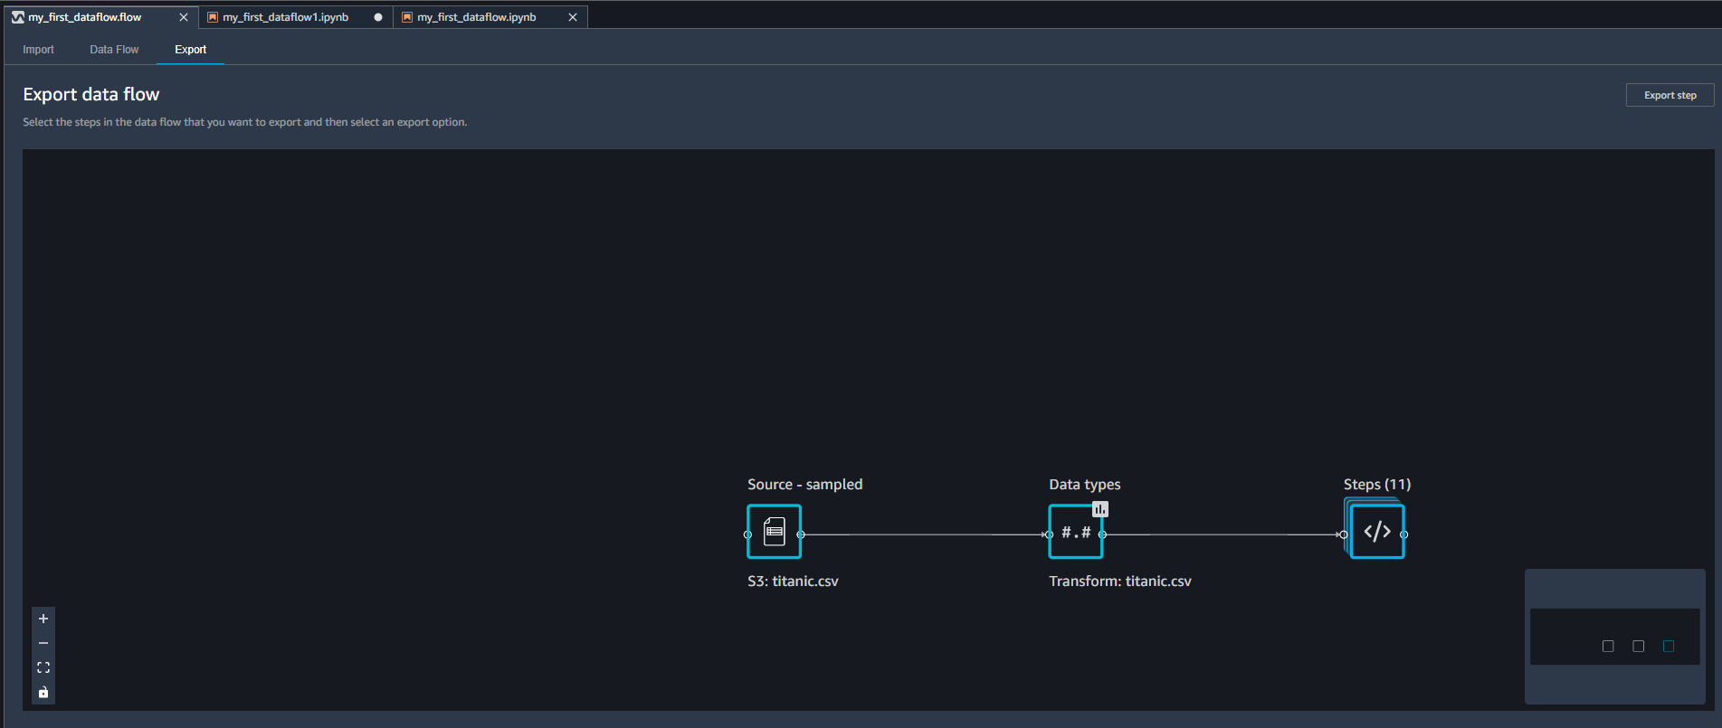
DATA WRANGLER DEMO
GO THE EXPORT TAB AND CLICK ON THE LAST STEP TO INCLUDE ALL THE STEPS

Slide 64
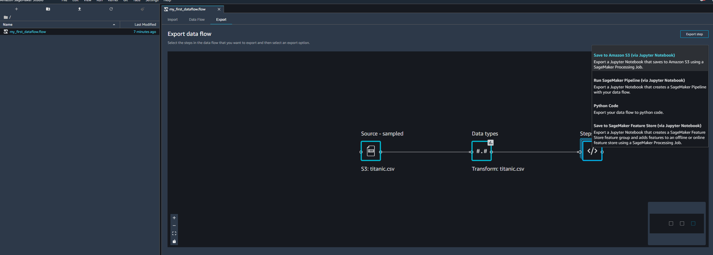
DATA WRANGLER DEMO
EXPLORE THE MANY OPTIONS TO EXPORT THE WORKFOW

Slide 65
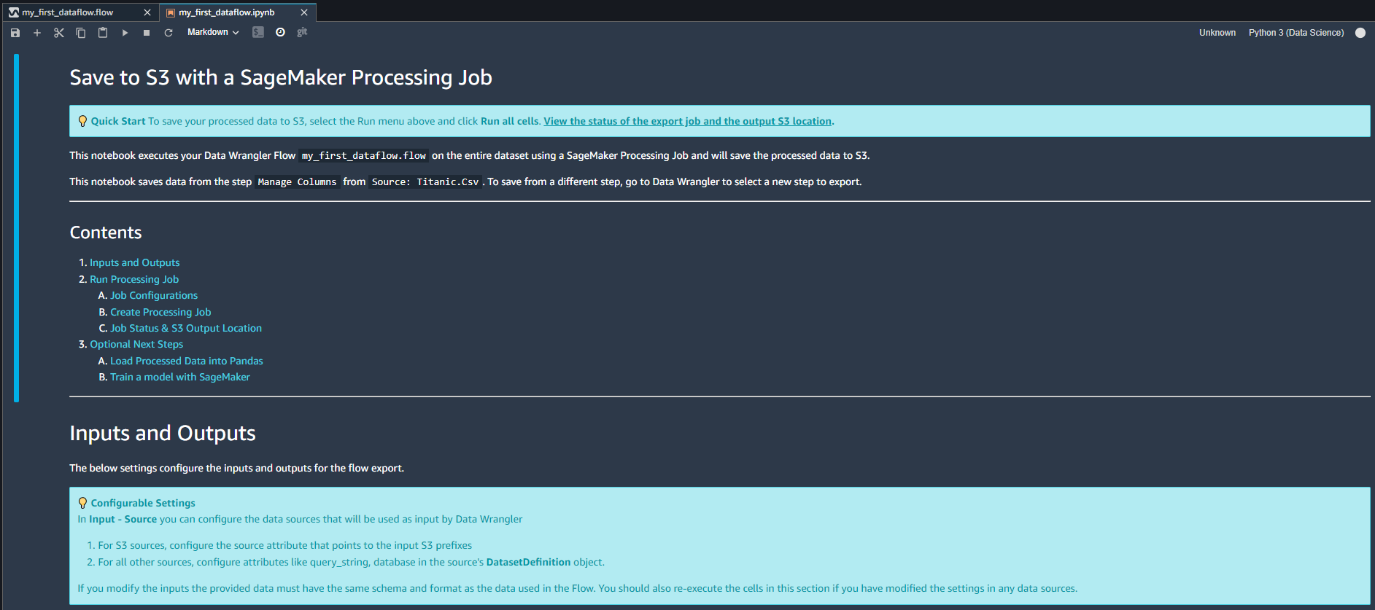
DATA WRANGLER DEMO
SELECT THE S3 OPTION AND RUN THE GENERATED NOTEBOOK

Slide 66
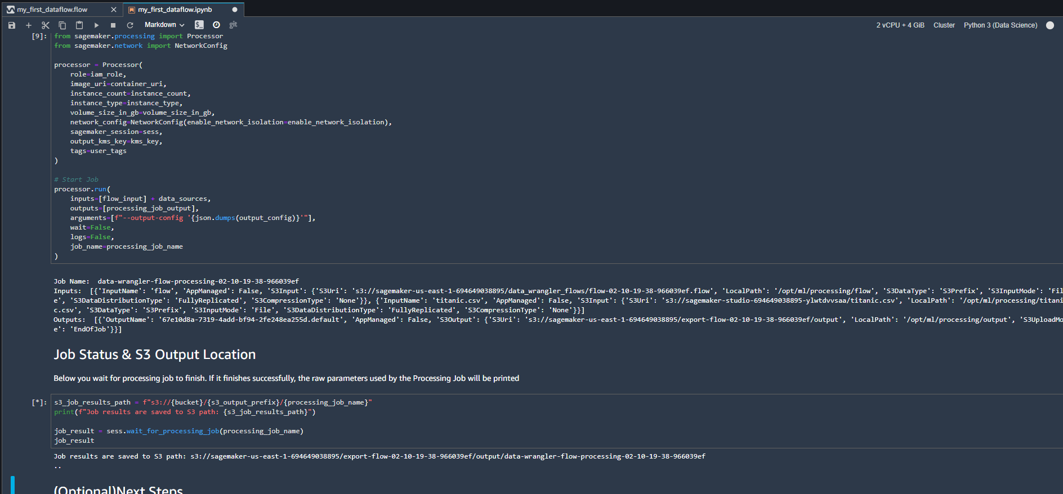
DATA WRANGLER DEMO
RUN THE CELLS. NOTE THAT THE RESULTS ARE ALSO SAVED IN S3

Slide 67
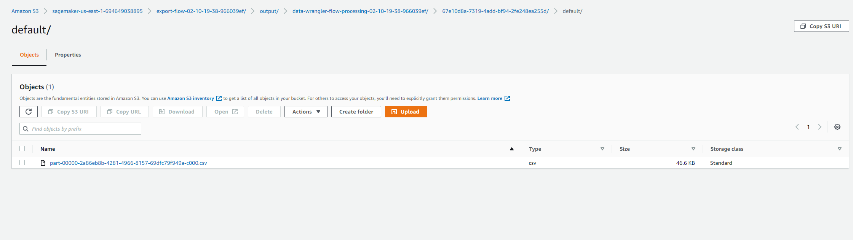
DATA WRANGLER DEMO
GO TO S3 AND DOWNLOAD THE PROCESSED DATASETS

Slide 68
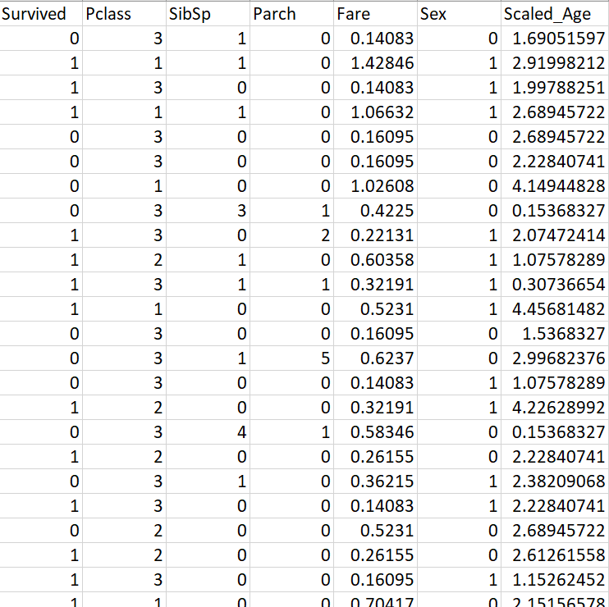
DATA WRANGLER DEMO
RUN THE CELLS. NOTE THAT THE RESULTS ARE ALSO SAVED IN S3

Slide 69
DATA WRANGLER DEMO #8: SHUTDOWN RESOURCES [IMPORTANT]
EASY
ADVANCED

Slide 70
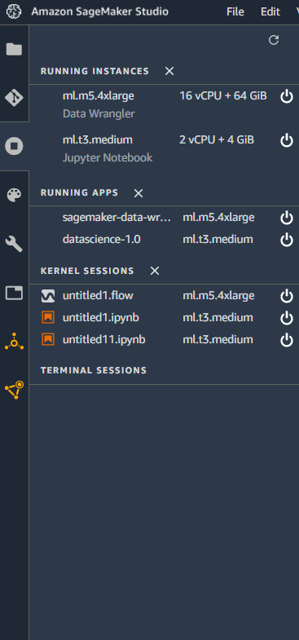
DATA WRANGLER DEMO [IMPORTANT]
CLICK ON POWER BUTTON TO SHUTDOWN ALL INSTANCES. THIS IS CRITICAL TO AVOID INCURRING ANY ADDITIONAL CHARGES.

Slide 71
FINAL END-OF-DAY CAPSTONE PROJECT
EASY
ADVANCED

Slide 72
FINAL PROJECT OVERVIEW
Using the “cardo.csv” dataset, use AWS data wrangler to perform the following tasks:
1. Upload the data to S3
2. Plot the histogram for the height column
3. Plot the scatterplot between the height and weight
4. Plot the correlation matrix between features
5. Drop the ID column
6. Create a custom formula to convert age column from days to years. Round the age to the nearest integer
7. Plot the histogram for the newly created age column
8. Generate a summary table and list the average age value
9. Sort the dataframe according the age column in an ascending order
10. Generate a bias report for the cholesterol column
11. Scale the weight, height, ap_lo and ap_hi using min max scaler
12. Export the workflow
13. Execute the code and explore the generated csv file

Slide 73

FINAL PROJECT OVERVIEW: DATA
Aim of the problem is to detect the presence or absence of cardiovascular disease in person based on the given features.
Features available are:
Age
Height
Weight
Gender
Smoking
Alcohol intake
Physical activity
Systolic blood pressure
Diastolic blood pressure
Cholesterol
Glucose
Data Source: https://www.kaggle.com/sulianova/cardiovascular-disease-dataset
Image Source: https://commons.wikimedia.org/wiki/File:Human_Heart_and_Circulatory_System.png

Slide 74
PROJECT SOLUTION
EASY
ADVANCED

Slide 75

PROJECT
UPLOAD THE DATA TO S3

Slide 76

PROJECT
UPLOAD THE DATA TO S3

Slide 77
PROJECT
PLOT THE HEIGHT HISTOGRAM

Slide 78

PROJECT
PLOT SCATTERPLOT BETWEEN HEIGHT AND WEIGHT

Slide 79

PROJECT
PLOT CORRELATION BETWEEN FEATURES

Slide 80

PROJECT
DROP THE ID COLUMN

Slide 81

PROJECT
CREATE A CUSTOM FORMULA TO CONVERT DAYS TO YEARS. ROUND THE VALUE TO THE NEAREST INTEGER.

Slide 82

PROJECT
PLOT THE HISTOGRAM FOR THE AGE COLUMN

Slide 83

PROJECT
GENERATE A SUMMARY TABLE.

Slide 84

PROJECT
SORT DATAFRAME IN AN ASCENDING ORDER USING AGE COLUMN

Slide 85

PROJECT
GENERATE A BIAS REPORT USING CHOLESTROL COLUMN

Slide 86

PROJECT
SCALE AGE, HEIGHT, WEIGHT, AP_HI AND AP_LO

Slide 87

PROJECT
EXPORT TO S3

Slide 88

PROJECT
NAVIGATE TO THE PATH SHOWN BELOW AND DOWNLOAD THE FILE

Slide 89
DATA WRANGLER DEMO [IMPORTANT]
CLICK ON POWER BUTTON TO SHUTDOWN ALL INSTANCES. THIS IS CRITICAL TO AVOID INCURRING ANY ADDITIONAL CHARGES.

